Slide 1
CSE 3400 - Introduction to Computer & Network Security (aka: Introduction to Cybersecurity) Lecture 4 Encryption – Part III (and Pseudo-randomness)
Ghada Almashaqbeh
UConn
From Textbook Slides by Prof. Amir Herzberg
UConn

Slide 2
Outline
Block ciphers.
Pseudorandom permutations (PRPs).
Defining security of encryption.
Encryption modes.
Concluding remarks.
2

Slide 3
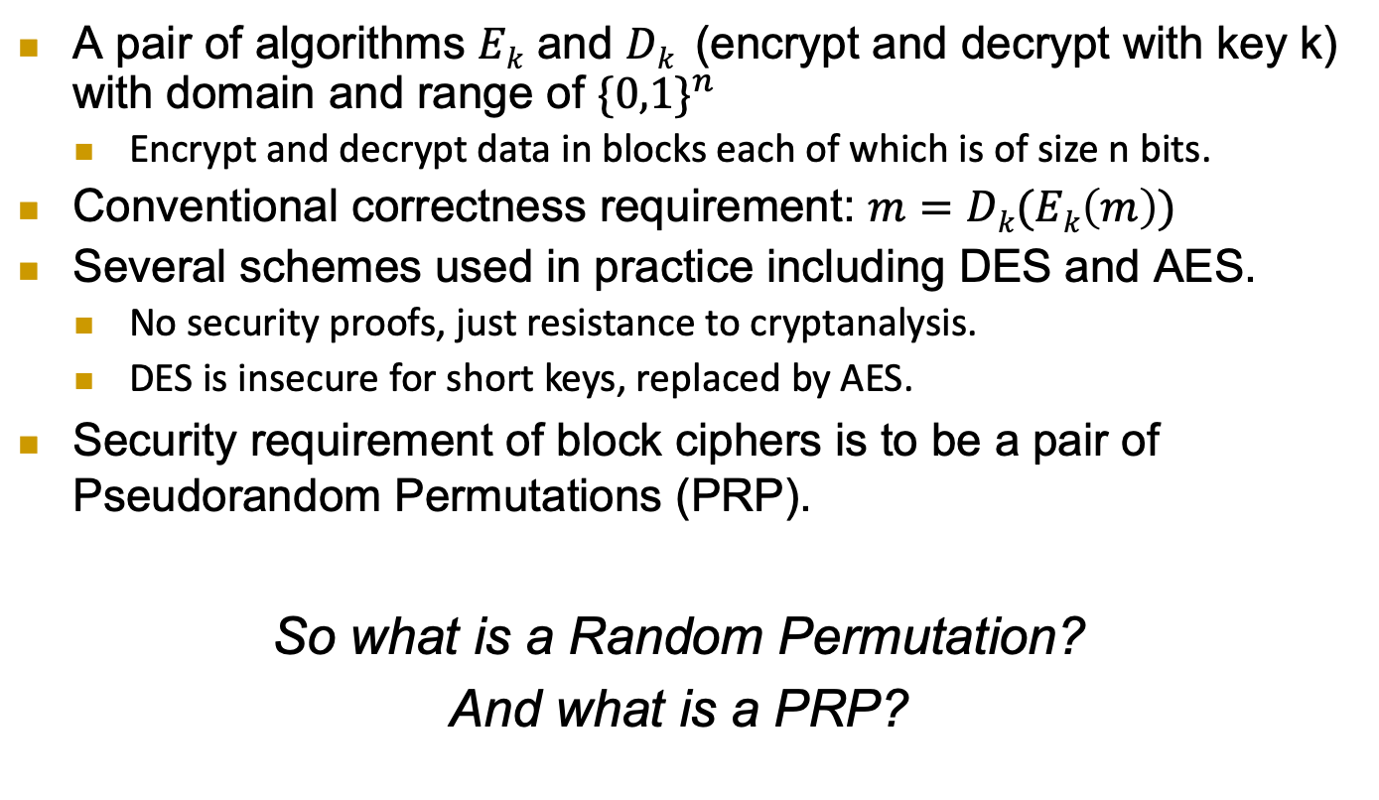
Block Ciphers
A pair of algorithms $Ek$ and $Dk$ (encrypt and decrypt with key k) with domain and range of ${\{0,1\}}^{n}$
Encrypt and decrypt data in blocks each of which is of size n bits.
Conventional correctness requirement: $m=Dk(Ek\left(m\right))$
Several schemes used in practice including DES and AES.
No security proofs, just resistance to cryptanalysis.
DES is insecure for short keys, replaced by AES.
Security requirement of block ciphers is to be a pair of Pseudorandom Permutations (PRP).
So what is a Random Permutation?
And what is a PRP?
3

Slide 4
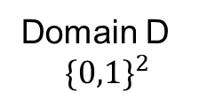
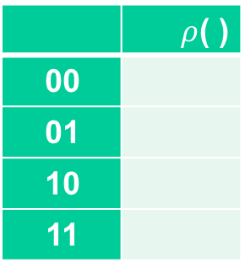
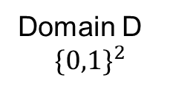
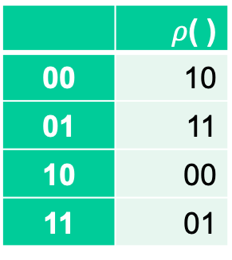
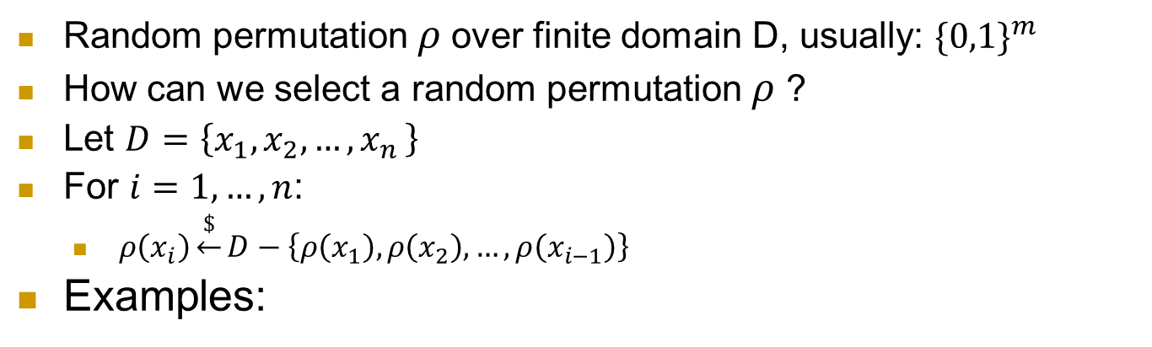
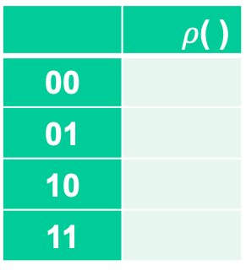

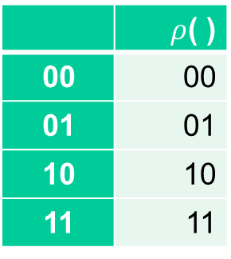
What is a random permutation $ρ$ ?
Random permutation $ρ$over finite domain D, usually: ${\{0,1\}}^{m}$
How can we select a random permutation $ρ$ ?
Let $D=\left\{x_{1},x_{2},…,x_{n }\right\}$
For $i=1,…, n$:
$ρ\left(x_{i}\right)\underset{←}{\$}D−\left\{ρ\left(x_{1}\right),ρ\left(x_{2}\right),…,ρ\left(x_{i−1}\right)\right\}$
Examples:
 | $ρ$( )
00
01
10
11
 | $ρ$( )
00 | 10
01 | 11
10 | 00
11 | 01
 | $ρ$( )
00
01
10
11
 | $ρ$( )
00 | 00
01 | 01
10 | 10
11 | 11
Domain D
$${\{0,1\}}^{2}$$
Domain D
$${\{0,1\}}^{2}$$
4

Slide 5


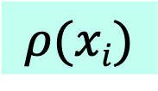
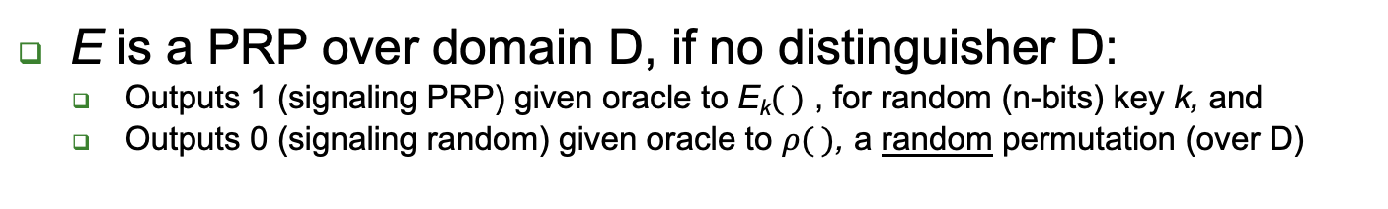
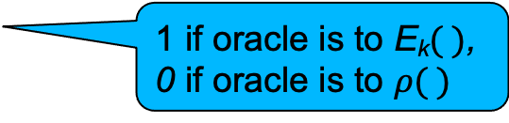
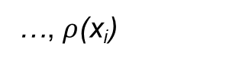
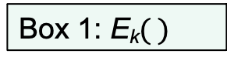
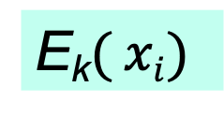
Pseudo-Random Permutation (PRP) and their Indistinguishabity Test
E is a PRP over domain D, if no distinguisher D:
Outputs 1 (signaling PRP) given oracle to E_{k}$( )$ , for random (n-bits) key k, and
Outputs 0 (signaling random) given oracle to $ρ( )$, a random permutation (over D)
n-bit Key k
k
x₁,x₂,…,x_{i}
x₁,x₂,…,x_{i}
E_{k}$( xi)$
?
$$ρ(xi)$$
…, E_{k}(x_{i})
…, $ρ$(x_{i})
Box 1: E_{k}$( )$
Box 0: random permutation
1 if oracle is to E_{k}$( )$,
0 if oracle is to $ρ( )$
5

Slide 6
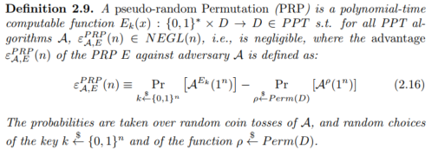
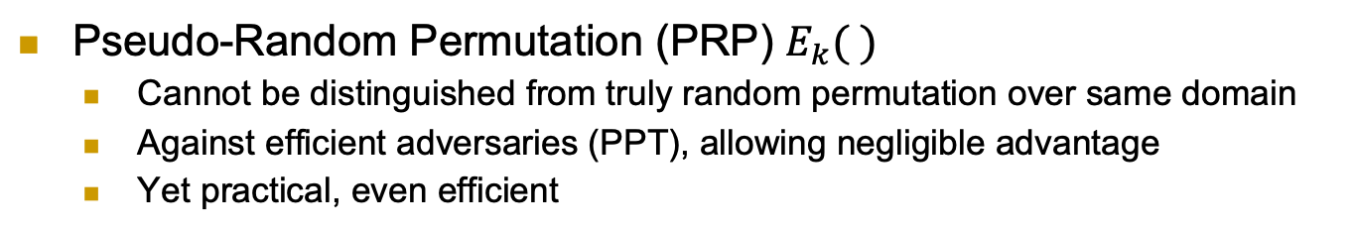
Pseudo-Random Permutation (PRP)
Pseudo-Random Permutation (PRP) $E_{k}( )$
Cannot be distinguished from truly random permutation over same domain
Against efficient adversaries (PPT), allowing negligible advantage
Yet practical, even efficient
6

Slide 7
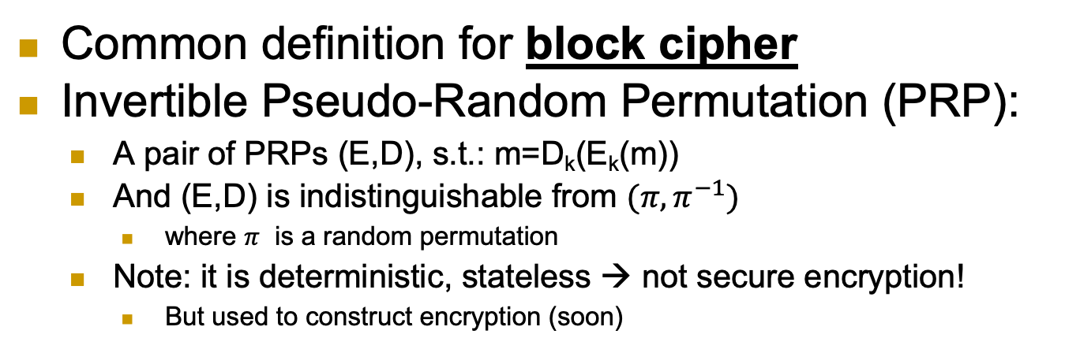
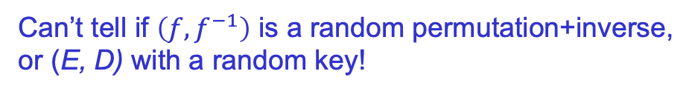
Block Cipher: Invertible PRP (E, D)
Common definition for block cipher
Invertible Pseudo-Random Permutation (PRP):
A pair of PRPs (E,D), s.t.: m=D_{k}(E_{k}(m))
And (E,D) is indistinguishable from $(π, π^{−1})$
where $π$ is a random permutation
Note: it is deterministic, stateless → not secure encryption!
But used to construct encryption (soon)
f← E_{k}( ) or D_{k}( ) [for random k]
or f← random n-bit permutation or its inverse
x
f(x)
Can’t tell if $\left(f,f^{−1}\right)$ is a random permutation+inverse, or (E, D) with a random key!
7

Slide 8
Example of a Block Cipher Security and Correctness
E_{k}(m) = m + k mod 2^{n}
In class.
D_{k}(c) ?
Correctness.
Is it secure?
8

Slide 9
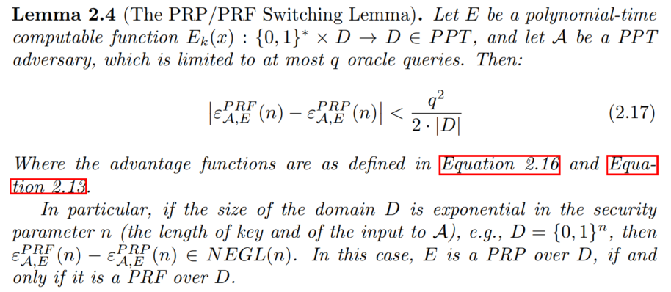
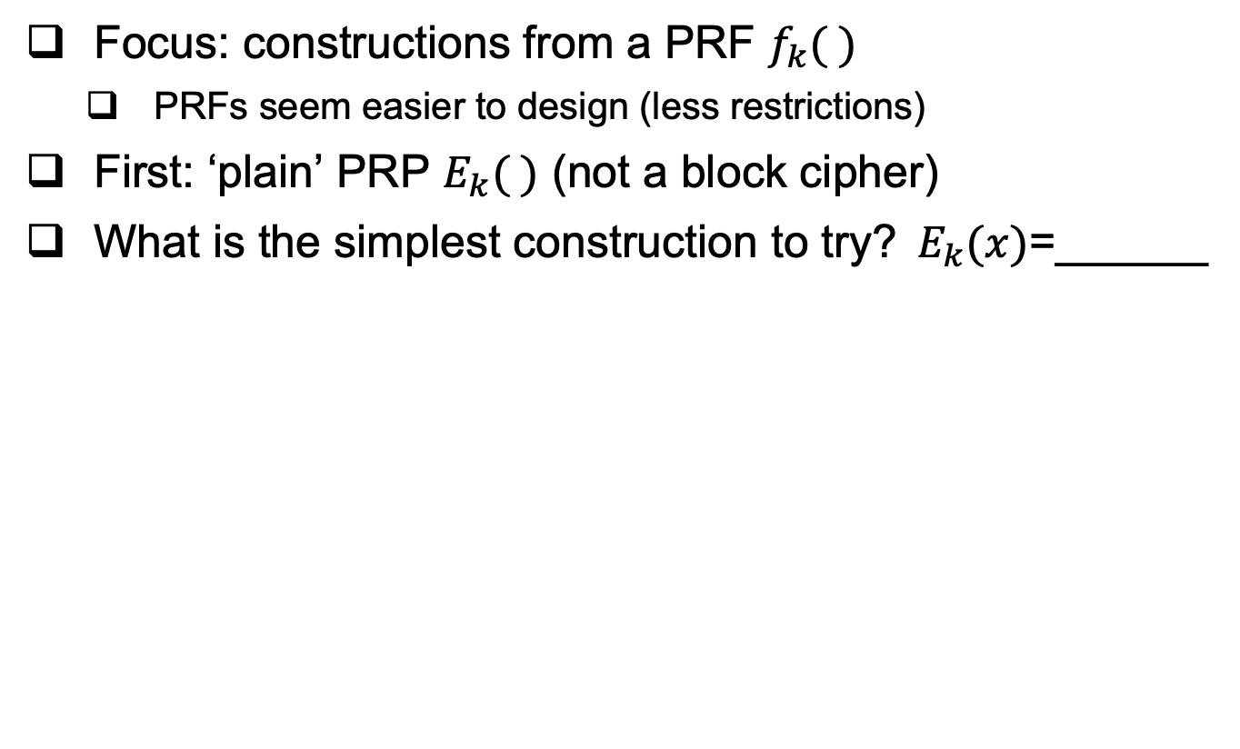
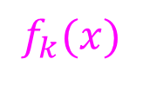
Constructing block-cipher, PRP
Focus: constructions from a PRF $f_{k}( )$
PRFs seem easier to design (less restrictions)
First: ‘plain’ PRP $E_{k}( )$ (not a block cipher)
What is the simplest construction to try?$E_{k}(x)$=______
$$f_{k}(x)$$
9

Slide 10
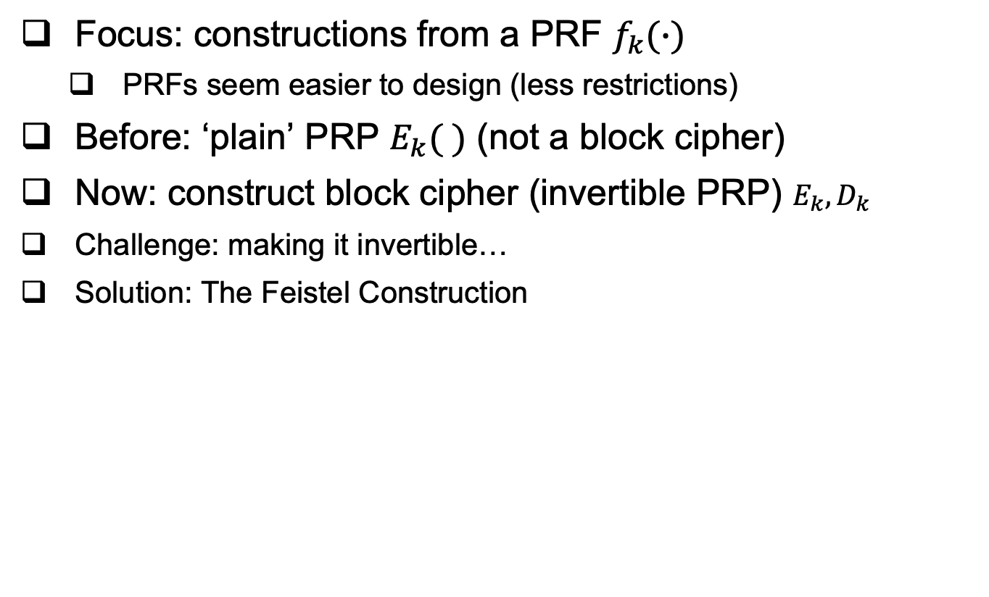
Constructing block-cipher, PRP
Focus: constructions from a PRF $f_{k}(∙)$
PRFs seem easier to design (less restrictions)
Before: ‘plain’ PRP $E_{k}( )$ (not a block cipher)
Now: construct block cipher (invertible PRP) $E_{k}, D_{k}$
Challenge: making it invertible…
Solution: The Feistel Construction
10

Slide 11
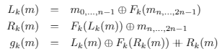
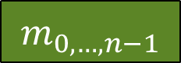
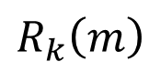
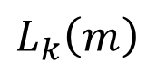
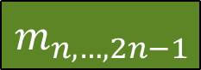

The Feistel Block-cipher Construction
Turn PRF F_{k} into a block cipher
Three ‘rounds’ suffice [LR88]
Used in DES (but not in AES)
With 16 ‘rounds’
$$m_{0,…,n−1}$$
$$m_{n,…,2n−1}$$
+
F_{k}()
$$L_{k}\left(m\right)$$
F_{k}()
+
F_{k}()
$$R_{k}\left(m\right)$$
+
$$g_{k}\left(m\right)$$
11

Slide 12

Crypto Building Blocks Principle
Design and focus cryptanalysis efforts on few basic functions: simple, easy to test, replaceable
Construct schemes from basic functions
Provably secure constructions: attack on scheme ➔ attack on function
Allows replacing broken/suspect functions
Allows upgrading to more secure/efficient function
E.g., encryption from block cipher (or PRG/PRF/PRP)
Block-cipher, PRG,PRF,PRP: deterministic, stateless, FIL (Fixed-Input-Length)
Encryption: randomized/stateful, VIL (Variable-Input-Length)
12
Notes:
Another advantage is that robust combiner for function usually gives robust combiner for scheme (and usually, it is simpler than direct combiner for scheme)

Slide 13
We defined security for PRG, PRF and PRP. Block cipher too (informally). But… what about security of encryption??
A bit tricky, in fact.
13

Slide 14
Defining Secure Encryption
Attacker capabilities:
Computational limitations ➔ PPT
Ciphertext only (CTO), Known / chosen plaintext attack (KPA/CPA), Chosen ciphertext (CCA)?
What’s a successful attack?
Key recovery ?
May be impossible yet weak cipher…
(Full) Message recovery?
What of partial exposure, e.g., m∈{“Advance”, “Retreat”}
Prudent: attacker ‘wins’ for any info on plaintext
14

Slide 15
Conservative Design Principle
When designing, evaluating a cryptosystem…
Consider most powerful attacker (CTO< KPA< CPA < CCA)
Be as general as possible – cover many applications
And `easiest’ attacker-success criteria
Not full message/key recovery!
Make it easy to use securely, hard to use insecurely!
When designing, evaluating a system (that uses some cryptographic primitives)
Restrict attacker’s capabilities (e.g., avoid known/chosen plaintext)
15

Slide 16
Cryptanalysis Success Criteria for Encryption
Learn anything at all about plaintext – how to define? Can we achieve it ?
Well-defined notion: ‘semantic security’ [crypto course]
So an encryption scheme is secure if the attacker cannot learn anything about the plaintext that he did not know in advance.
Indistinguishability: Eve ‘wins’ if she distinguishes between encryptions of (any) two messages
The attacker chooses these two messages.
We focus on indistinguishability for CPA attacker. In crypto course: equivalent to semantic security
16

Slide 17
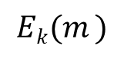
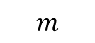
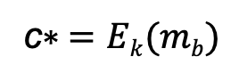
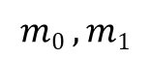

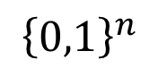
IND-CPA-Encryption Test (1st try)
Flip coins to select random bit b and key k
A (adversary) gives message m, receives E_{k}(m)
Repeat if desired (with different messages m)
Chosen Plaintext Attack
A gives two messages (m₀,m₁), receives c*=E_{k}(m_{b})
A output b* , and ‘wins’ if b*=b
$$n,b$$
$$m$$
$
A
k
$${\left\{0,1\right\}}^{n}$$
$$Ek(m )$$
E_{k}(.)
$$m0 , m1$$
c$∗ =Ek(mb)$
A wins if b*=b
b*
17

Slide 18
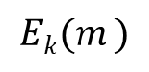
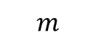
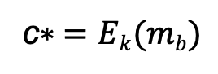
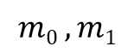

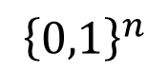
IND-CPA-Encryption Test (1st try): too easy
This test is too easy!! The adversary can easily win!!
How?
Hint: messages can be arbitrary binary strings
Namely, m, m₀ , m₁ ∈ {0,1}^*
Solution: let m₀=0 , m₁=111111111111111111
If c*=E_{k}(m_{b}) is `short’, output b*=0; if ‘long’, output b*=1
$$n,b$$
$$m$$
$
A
k
$${\left\{0,1\right\}}^{n}$$
$$Ek(m )$$
E_{k}(.)
$$m0 , m1$$
c$∗ =Ek(mb)$
A wins if b*=b
b*

Slide 19
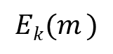
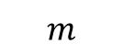
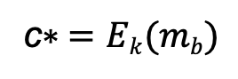
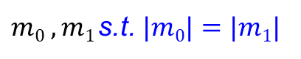

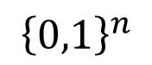
IND-CPA-Encryption Test (fixed)
Flip coins to select random bit b and key k
A (adversary) gives message m, receives E_{k}(m)
Repeat if desired (with another message)
Chosen Plaintext Attack
A gives messages (m₀,m₁) s.t. |m₀|=|m₁| , receives E_{k}(m_{b})
A output b* , and ‘wins’ if b*=b
$$n,b$$
$$m$$
$
A
k
$${\left\{0,1\right\}}^{n}$$
$$Ek(m )$$
E_{k}(.)
$m0 , m1$s.t. $|m0|=|m1|$
c$∗ =Ek(mb)$
A wins if b*=b
b*

Slide 20
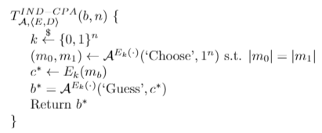
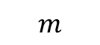
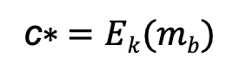
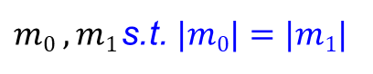

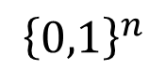
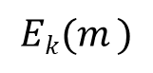
IND-CPA-Encryption Test (fixed)
Oracle notation
Or, as pseudo-code:
$$n,b$$
$$m$$
$
A
k
$${\left\{0,1\right\}}^{n}$$
$$Ek(m )$$
E_{k}(.)
$m0 , m1$s.t. $|m0|=|m1|$
c$∗ =Ek(mb)$
A wins if b*=b
b*

Slide 21
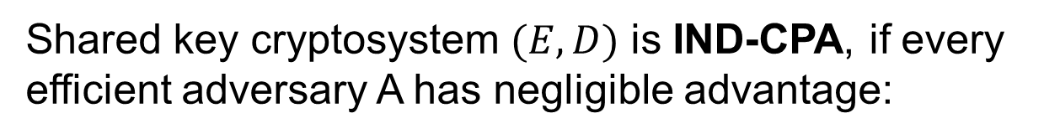
Definition: IND-CPA Encryption
Shared key cryptosystem $(E,D)$ is IND-CPA, if every efficient adversary A has negligible advantage:

Slide 22
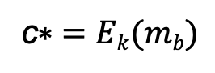
Can IND-CPA encryption be deterministic?
No!! But why? Suppose E_{k}(m) is deterministic…
Assume messages are words.
A can ask E_{k} to encrypt m₀ and m₁ and then check which one is equal to the challenge ciphertext → always wins!
Conclusion: IND-CPA Encryption must be randomized
Even if you encrypt the same m over and over again, a new ciphertext will be produced.
$$n,b$$
$$m$$
$
A
k
$${\left\{0,1\right\}}^{n}$$
$$Ek(m )$$
E_{k}(.)
$m0 , m1$s.t. $|m0|=|m1|$
c$∗ =Ek(mb)$
A wins if b*=b
b*

Slide 23
What’s next? Present a secure cryptosystem? … provably secure w/o assumptions ? Unlikely: Proof of security ➔ P ≠ NP (similar argument to PRF) Instead, let’s build secure encryption from PRFs ! (I.e.: PRF is secure ➔ encryption is IND-CPA) Actually, we’ll use block cipher (recall the PRF/PRP switching lemma) to build encryption schemes under what is called “Modes of operation.”
23

Slide 24
Examples
Let F be a PRF.
E_{k}(m) = F_{k}(0^{n}) xor m
E_{k}(m) = (r, F_{k}(r) xor m) where r is a random string freshly generated for each message.
24

Slide 25
Encryption: Modes of Operation
`Modes of operation’: use block cipher (PRP), to encrypt long (Variable Input Length, VIL) messages
Randomize/add state for security
Often: use random or stateful Initialization Vector (IV)
Use long keys
Better security (at least against exhaustive search)
Assume plaintext is in blocks: m₀||m₁||…
An integer number of blocks, each block is n bits.

Slide 28
Encryption Modes of Operation
28

Slide 29
Electronic Code Book mode (ECB) I
Encryption c_{i}=E_{k}(m_{i}), decryption m_{i}=D_{k}(c_{i})
Each m_{i} is n bit block and same for ci

Slide 30



Electronic Code Book mode (ECB) II
Encryption c_{i}=E_{k}(m_{i}), decryption m_{i}=D_{k}(c_{i})
Insecure!! (do not use it!) Which of these is ECB encryption? Why?

Slide 31


Output-Feedback (OFB) Mode
Goal: encrypt long (multi-block) messages, with less random bits
How? Use random bits only for first block (`initialization vector’)
To encrypt next blocks of message, use output of previous block
Namely, a block-by-block stream cipher
Encryption: pad₀←IV, pad_{i} ← E_{k}(pad_{i-1} ), c₀ ← pad_{0,} c_{i} ← pad_{i}⊕ m_{i}
Decryption: pad₀ ← c_{0,} pad_{i} ← E_{k}(p_{i-1} ), m_{i} ← pad_{i}⊕ c_{i}
31

Slide 32
Output-Feedback (OFB) Mode
Offline pad computation: compute pad in advance
Online computation: only (parallelizable) XOR !
Bit errors are bitwise localized
Corrupting a one bit in the ciphertext corrupts only one bit in the plaintext.
32

Slide 33
Cipher Block Chaining (CBC) Mode
Random first block c₀ (`initialization vector’, IV)
i>0: c_{i} = E_{k}(c_{i-1} ⊕ m_{i}), m_{i} = c_{i-1} ⊕ D_{k}(c_{i})
Parallel decryption
But no offline precomputing
How about encryption? Sequential (it is a chain!)
Error propagation:
flip bit in c[i] ➔ flip bit in m[i+1] and corrupt m[i]
Notes:
33
10/30/11

Slide 34
Security of CBC mode
Theorem: If block-cipher E is a (strong) pseudo-random permutation ➔CBC is IND-CPA-secure encryption
Proof: omitted (crypto course ☺ )
Observation: CBC is Not IND-CCA-Secure
CCA (Chosen ciphertext attack), intuitively: attacker can choose ciphertext and get its decryption, except for the `challenge ciphertext’
Definition, details: crypto course
Exercise: show CBC is Not IND-CCA-Secure
Other variants of CBC exists that are CCA secure.

Slide 35

Counter (CTR) Mode
Random counter (or `initialization vector’, IV, or s)
i>0: c_{i} = E_{k}(s+ i) ⊕ m_{i}
m_{i} = E_{k}(s + i) ⊕ c_{i}
Parallel encryption and decryption with offline precomputing
If a PRF is used for the PRP (for E_{k}), then it is CPA (provably secure).
Error propagation:
flip bit in c_{i} ➔ flip bit in m_{i}
Notes:
35
10/30/11

Slide 36
Encryption: Final Words
Supports one of the basic goals of cryptography; confidentiality.
Focus: computationally-limited adversaries
Principles:
Kerckhoff’s: Known Design
Sufficient Key Space
Crypto Building Block: build schemes from simple, standard functions
Constructions & reductions: PRG→PRF→PRP→Enc
Secure system design: easy to use securely, hard to use incorrectly!

Slide 37
Encryption: Final Words...
Many variants…
One important example is Homomorphic encryption:
E(m₁+m₂)= E(m₁) + E(m₂)
Fully-homomorphic: also
E(m₁*m₂)= E(m₁)*E(m₂)
Inefficient, huge keys and ciphertexts… but lots of advances and ongoing research!

Slide 38
Covered Material From the Textbook
Sections 2.6, 2.7, 2.8, and 2.11 excluding:
2.7.3
PBR from 2.8.2,
“Encode-then-Encrypt considered harmful.” from 2.8.3
2.8.4,
2.8.6.

Slide 39

Thank You!

